Slide 1
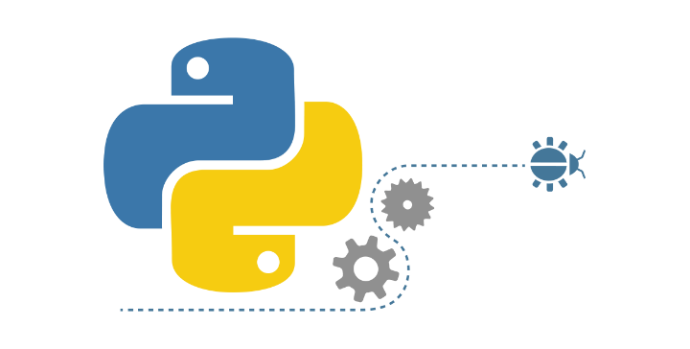
Coding in Python:
Introduction & Theory
Level: Beginner/Intermediate
Last update: 03/12/2022
Notes:
Changed title to be same as our module

Slide 2
PART 1: The Basics

Slide 3
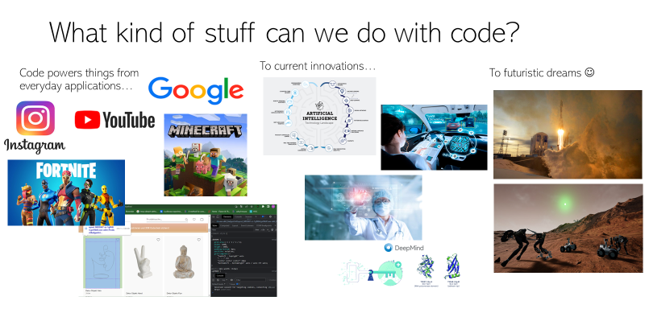

Slide 4
But what exactly is programming?

Slide 5
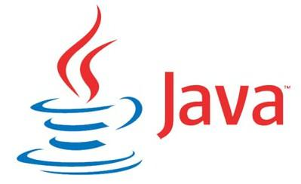
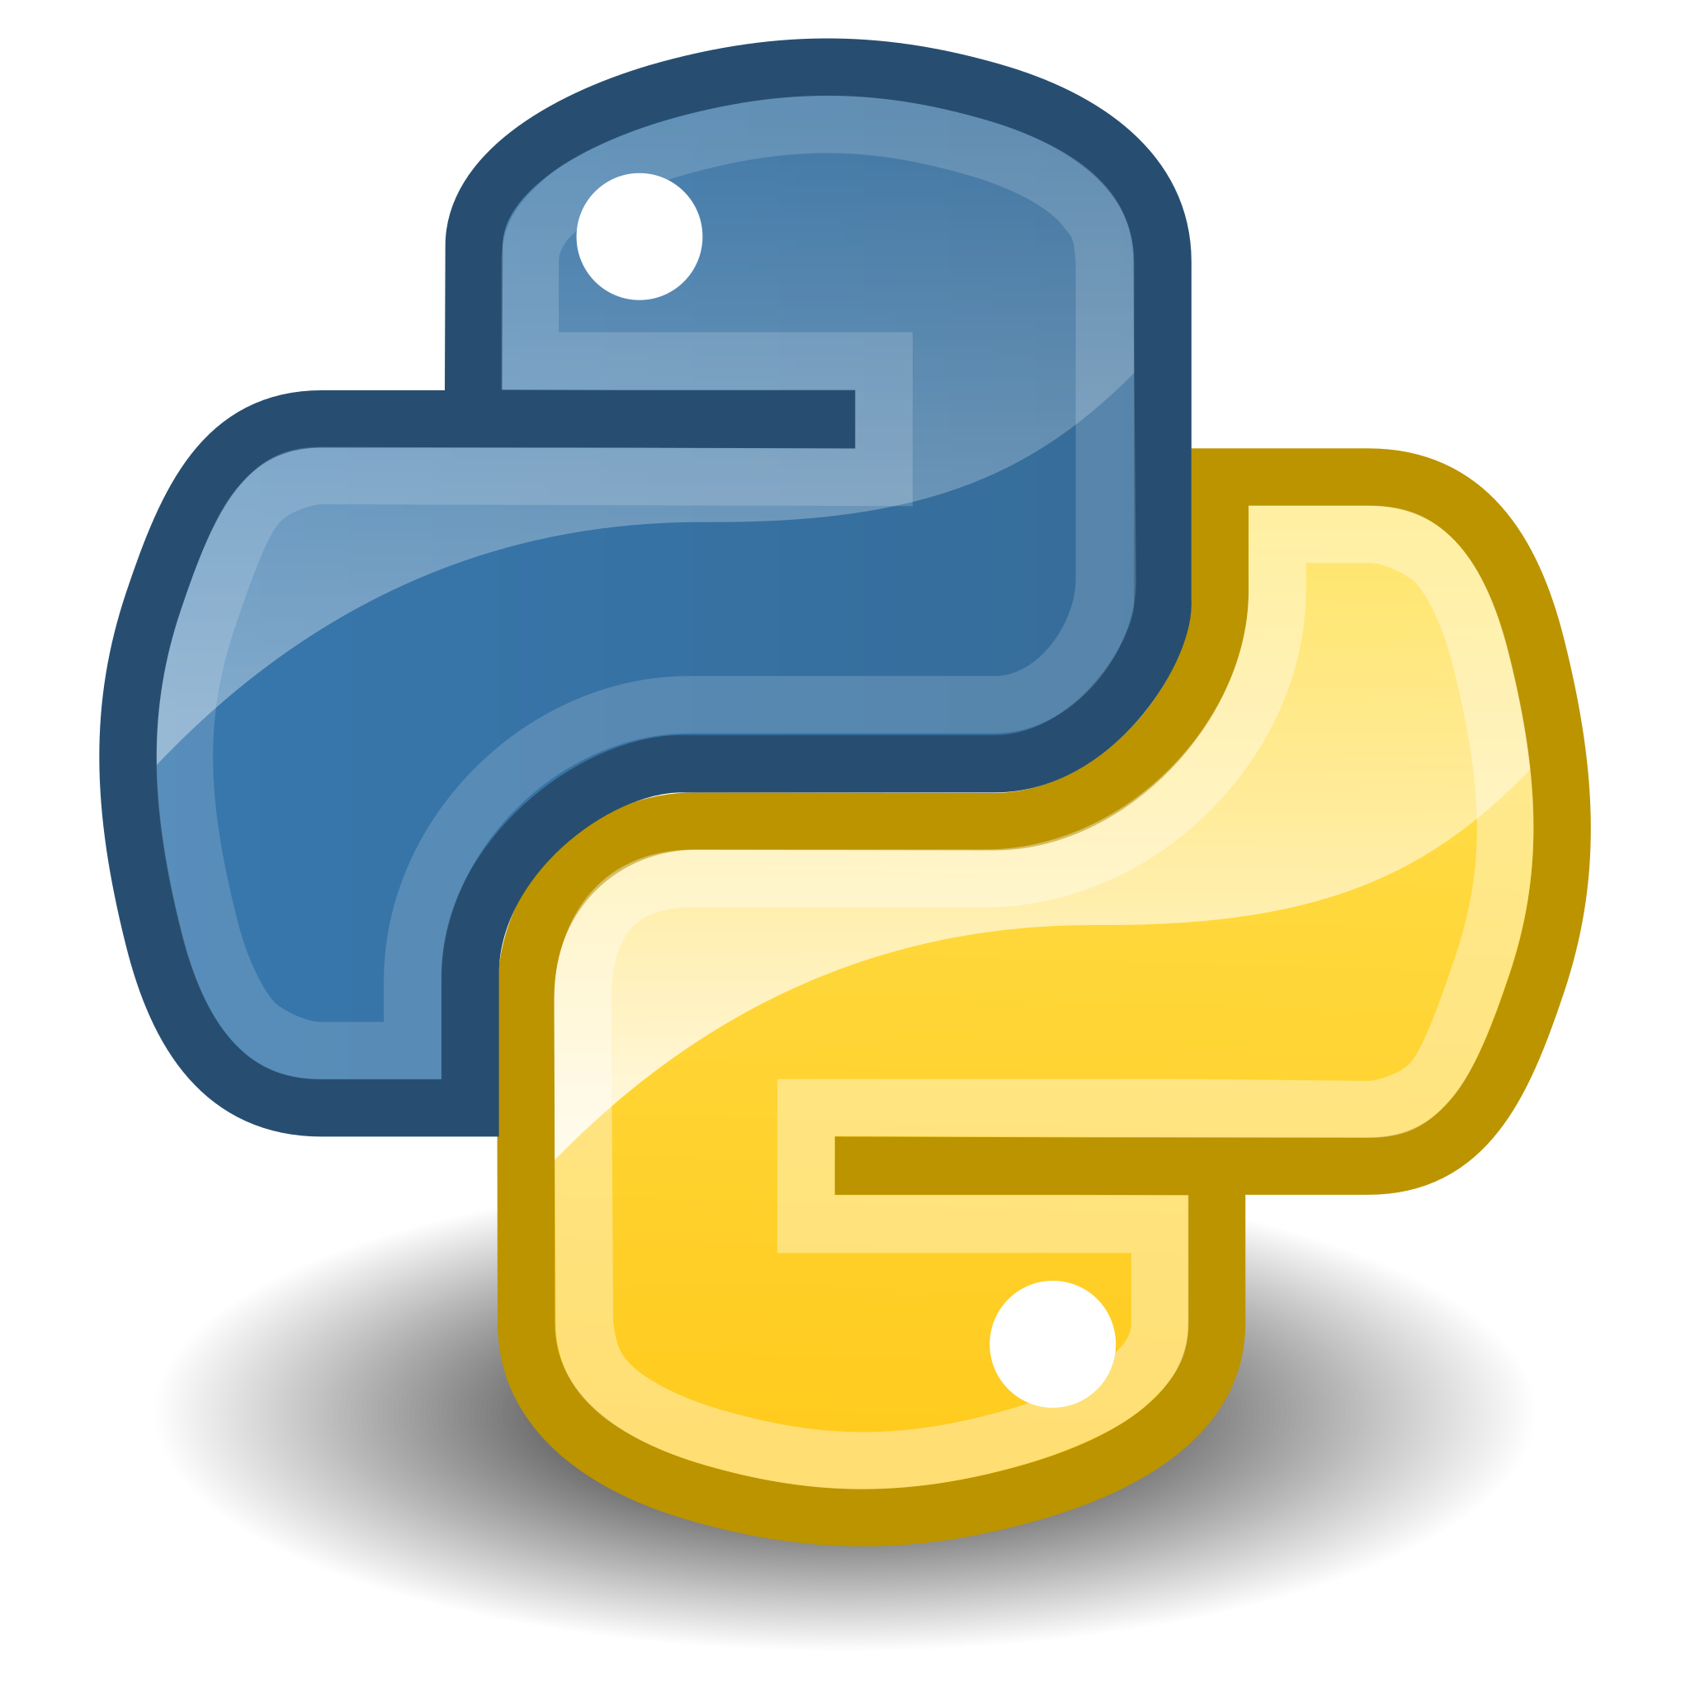
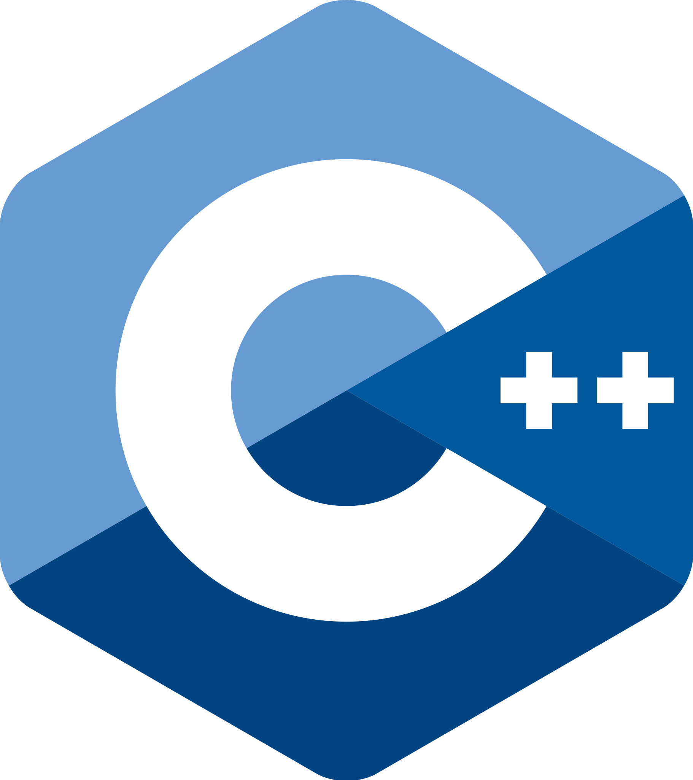
Programming
Programming, or coding => telling a computer what to do by giving it precise commands to which it responds.
How do we tell a computer what to do? => With code
A programming language is just a language that both the computer and you can understand.
Code is written in various languages:
Java
Python
C++
Have you heard of any of these languages? Do you know any others?

Slide 6
Algorithms
When we code, we usually implement an algorithm. An algorithm is simply a list of steps that you follow to finish a task.
We can formulate lots of the tasks we complete every day as algorithms. Imagine yourself explaining something you do every day, like brushing your teeth, to an alien.
The human teeth-brushing algorithm:
Take the tube of toothpaste into your hand
Screw off the cap
Take your toothbrush into your hand
…how does it continue?
What are some other things in your daily life that could be formulated as algorithms? Think of some examples!

Slide 7
Example of an algorithm
Put the flour in a bowl
Heat a lightly oiled frying pan over medium heat
Pour the batter onto the pan, brown on both sides and serve hot
Make a well in the center
Scramble, while adding the milk
Add the eggs, the butter, the sugar

Slide 8
Another example: oven temperature
Read the temperature of the oven and remember it
Start
Is the oven temperature equal to the target temperature?
Is the oven temperature smaller than the target temperature?
Stop the oven for a moment
No
No
Yes
Raise the oven power
Yes
Keep the oven at the same power

Slide 9
How to create a ”program”?
1st step : design an algorithm
2nd step : translate it for the computer
But which language does the computer understand?

Slide 10
Translation for the computer
Problem : Our computer only understands ‘0’s and ‘1’s!
Solution : Use a programming language!

Slide 11
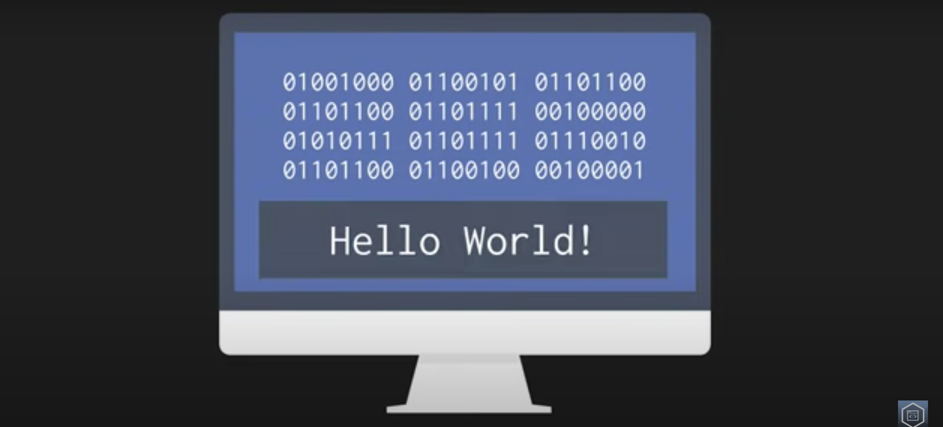
Binary language
Computers don‘t understand these types of verbal instructions, because they don‘t speak our language. We need to write our algorithm in the form of a program that our computer understands.
Computers technically only understand combinations of 0s and 1s. Everything that we tell a computer is eventually translated into 0s and 1s.
The 0 or 1 corresponds to physical states like „on“ or „off“ (flow of electricity/no flow)
‘A’, for example is translated into 00000, B in 00001 etc.
https://www.youtube.com/watch?v=0Exik_Q3kDk

Slide 12
What is a programming language?
A programming language is a bridge between the computer and humans. It is a language that we can understand and that can be translated to binary format(1s and 0s) by the computer
The program will translate it to binary
Your computer will understand 010001100101
In your program you will write: please do the computation 13+2
https://www.youtube.com/watch?v=EGQh5SZctaE
Notes:
It’s a way to speak with the computer

Slide 13
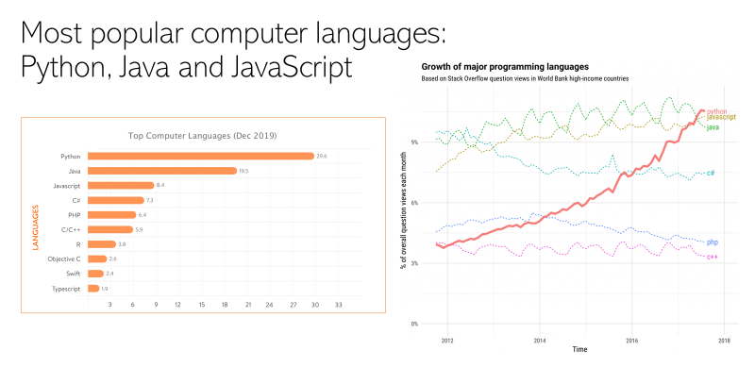

Slide 14
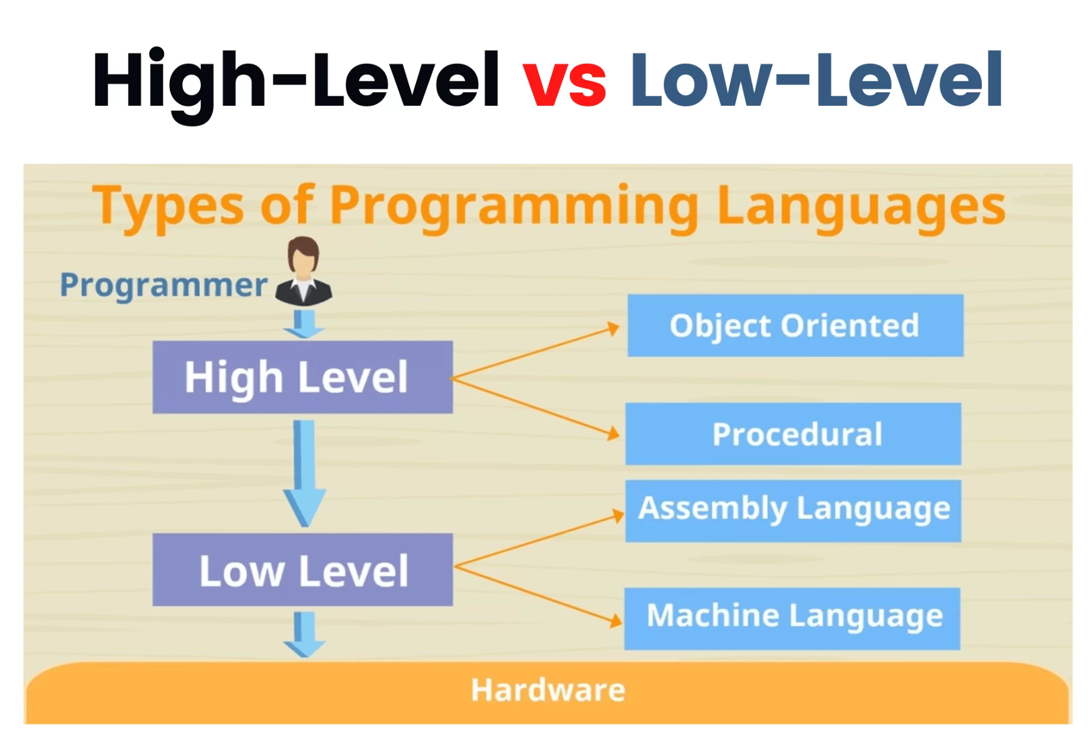
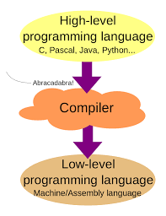
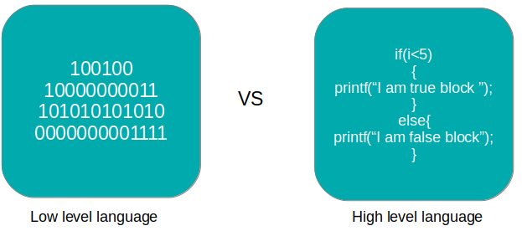
Levels of description
Notes:
Thinking back to our algorithm examples - you could imagine going into each of these steps in more or less detail.
For example you could break up step 1 („take the tube of toothpaste into your hand“) into a lot of little steps (reach with your hand, put your fingers around tube, lift your hand with the toothpaste etc.)
In programming languages, we distinguish between those that are at Higher levels of description, which allow you to program complex things with fewer lines of instruction. However, you have less control over individual steps. For example, in the line „take the tube of toothpaste into your hand“, your program would not know what to do if the toothpaste is in a cabinet which needs to be opened.
Lower-level programming languages give you more control over individual steps, but therefore also usually require more lines of code in total.

Slide 15
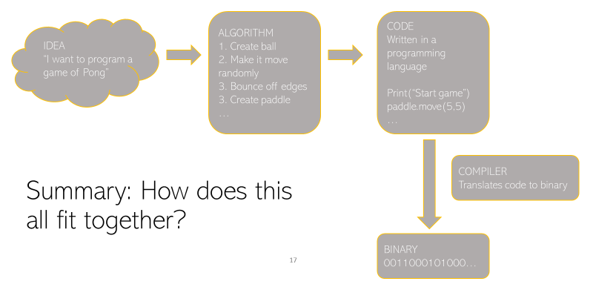

Slide 16
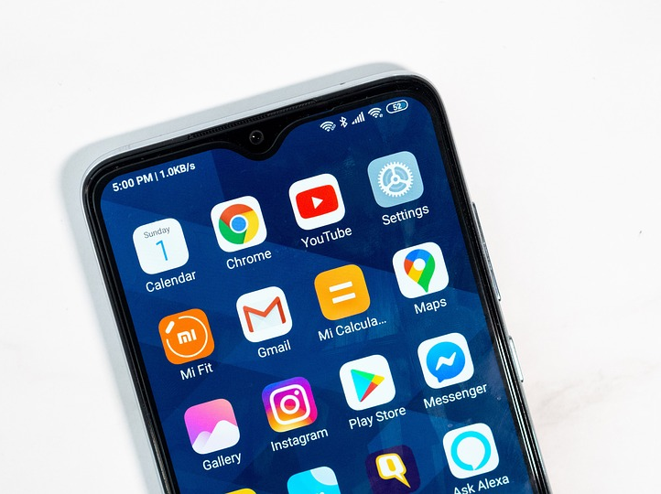



What can you do with Python?
Python is a high-level programming language => easy to use, but you can build very complex things! For example…
Mobiles and Desktop apps
Websites: Instagram, Youtube, Dropbox, and even Google are made with python
You can even make some operating systems! (Linux is partly made with Python)
And, importantly, games :)

Slide 17
PART 2: Python Fundamentals

Slide 18
Section 2: Fundamentals of Programming
Variables and Data types
Lists
Conditional structures and operators
Loops
Functions
Object Oriented Programming

Slide 19
2.1 Variables

Slide 20
Let’s go back to our algorithm…
We need a way to remember the temperature!
Read the temperature of the oven and remember it
Start
Is the oven temperature equal to the target temperature?
Is the oven temperature smaller than the target temperature?
Stop the oven for a moment
No
No
Yes
Raise the oven power
Yes
Keep the oven at the same power

Slide 21
What is a variable?
It is a place in your code where you can store a piece of information so that you can use it later!
Example :
my_age = 15
my_name = « Claire »
Name of the variable
Value of the variable
Equal sign

Slide 22
What is a type?
A variable always have a type. It tells the computer what kind of data is inside the variable. You often don’t have to bother with the type in Python but it is good to know what it is about.
Here is a list of common variable types :
Int: integer values (Ex : -1 , 10)
Float: floating point values (Ex : 2.5, 10.2039)
String: (Ex : “I’m learning Python”)
Boolean: True or False
There is more variables types but we are going to see them later.
Notes:
AGE != age
Only numbers, letters and _
Two major conventions : myAge, my_age
Show live example : myWeight = 85
Show live example : type(a) => analogy with 3/7
Do someone know what we are doing when using type()
Number of digits are not infinite (nothing is infinite in computer science)
myWeight = 85
myWeight = myWeight + 5
myWeight += 5
myString = ‘Hey techspark community’
myString = ‘I don’t understand Python’
quote = “”Tell me and I forget. Teach me and I remember. Involve me and I learn.””
quote =“\”Tell me and I forget. Teach me and I remember. Involve me and I learn.\””
Append text (Python understand differently + according to the type)
type,print were functions.

Slide 23
Switching between types
Python has some inbuilt functions => these are methods the developers already coded for you, which you can use to do certain things.
One of the things you can to is convert the content of a variable from one data type into another.
For example, you might want to convert the string myage = ‘15’ into the integer 15.
=> str()
=> int()

Slide 24
Zooming in on strings
Strings are variables that contains text.
We can display text using the print command (Ex: print(”Hello”))
The command name = input(”What is your name?”) displays “What is your name?”, then let the user enter some text and store the result into the name variable.

Slide 25
Change the case of a string
The case of a string is the way it is written : “I LOVE PYTHON” is in uppercase while "i love python" is in lowercase.
There are some very useful Python functions to change the case of a string!
Let's define str = "My Name Is Julien"
str.lower() is going to return "my name is julien"
str.upper() is going to return "MY NAME IS JULIEN"

Slide 26
String concatenation
Sometimes you may want to combine two strings together: this is called string concatenation and you can do it with the + operator.
Example: "My name is " + "Julien" will return "My name is Julien"
This is especially useful to display some variables alongside with some text:
Example:
age = 16
print("My age is " + str(age))

Slide 27
2.2 Lists

Slide 28
What are lists?
Sometimes, we wish to store a lot of data, to reuse it later.
In those cases, we don’t want to create a variable for each piece of data we wish to store. We use lists instead.
Syntax :
myList = [] creates a new empty list
myList = [1, 3, “Python”, 10.5] creates a list with some elements inside already
You can put anything in a list, even elements of different types.

Slide 29
Accessing elements of a list
You often want to access elements you’ve stored in a list. Is is pretty straightforward:
If you have a list myList defined like that:
myList = [1, 3, ‘Python’, 10.5]
You can get the i_{th} element of the list with:
myList[i]
Be careful, lists in python starts with element 0!
For example myList[1] is 3 here.

Slide 30
Adding an element to a list or modify one
myList = [1, 3, ‘Python’, 10.5]
To get the number of elements in myList, I can do len(myList)
To modify one element of myList, I can do myList[1] = 4
But doing myList[4] = 6 to add an element at the end of the list and make its
value be 6 would not work because our list has only 4 elements, the element
myList[4] does not exist !
Instead we have to do: myList.append(6)
This changes the second element of the list because lists indices start at 0

Slide 31
Recap: What have we learned so far?
How can we make this string all lowercase? mystring = ‘hELLo’
How can we combine these two strings? sentence = ‘My name is ‘ name = ‘Arianna’
How can we store multiple pieces of data in 1 variable?
How do you access a specific element of a list?

Slide 32
2.3 Conditional Structures and operators

Slide 33
Let’s go back to our algorithm…
Read the temperature of the oven and remember it
Start
We need to be able to take decisions !
Is the oven temperature equal to the target temperature?
Is the oven temperature smaller than the target temperature?
Stop the oven for a moment
No
No
Yes
Raise the oven power
Yes
Keep the oven at the same power

Slide 34
How to do that in Python?
Simple form : if if condition:
do something
Complete form : if, elif and else
if condition:
do something
elif other condition:
do something else
else: do something else
Notes:
Example with if (a < 0)
Example with if complete synthax

Slide 35
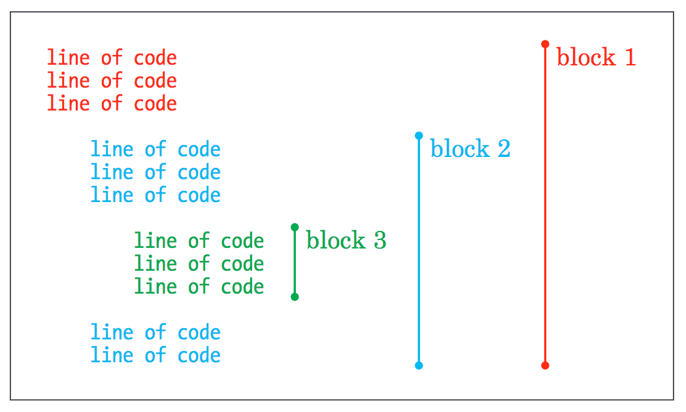
Code Blocks
In Python the only way to see if a line of code is in or out of an “if” condition is with indentations. So be very careful with them.
Notes:
AGE != age
Only numbers, letters and _
Two major conventions : myAge, my_age
Show live example : myWeight = 85
Show live example : type(a) => analogy with 3/7
Do someone know what we are doing when using type()
Number of digits are not infinite (nothing is infinite in computer science)
myWeight = 85
myWeight = myWeight + 5
myWeight += 5
myString = ‘Hey techspark community’
myString = ‘I don’t understand Python’
quote = “”Tell me and I forget. Teach me and I remember. Involve me and I learn.””
quote =“\”Tell me and I forget. Teach me and I remember. Involve me and I learn.\””
Append text (Python understand differently + according to the type)
type,print were functions.

Slide 36
Example 1
Output :
increase the power
The program is done
temperature = 120
if temperature < 180:
print(“increase the power”)
else:
print(“lower the power”)
print(“The program is done”)
What is going to be printed by this program?

Slide 37
Example 2
trees = 50
if trees > 100:
print(“forest”)
else:
print(“not a forest”)
What is going to be printed by this program?

Slide 38
The input() function
Example:
myage = input(“What is your age? ”)
the prompt which python will show you, to which you type your answer
variable in which your answer is stored as a string
This is an INBUILT function, meaning that the Python developers defined it for you. We will learn how to define and use our own, custom functions later on!

Slide 39
Recap: What have we learned so far?
What is programming?
What is an algorithm?
What language do computer “speak”?
How can we still communicate with them?
What is a variable?
What types of data can a variable contain?
Does indentation matter in Python?
What is a conditional statement?

Slide 40
Basic Operators
Basic Operators: + , - , / , * , %
Comparison Operators:
> Greater than
< Lower than >= Greater than or equal to
<= Lower than equal to
== Equal to
!= Different than
a = 0 #one '=' means we affect 0 to the variable ‘a’
a==5 #test if ‘a’ is equal to 5 a > -8 #test if ‘a’ is greater than -8
Notes:
Comparison operators : ==, !=, >, <, >=, <=
Key words example : and, or, not => I like basketball and I don’t like soccer, negation
Lab
Optimize predicate (only one if else)

Slide 41
The % operator
The % operator is used to computer the remainder of the division !
Example :
10%3 = 1 because the reminder of 10/3 is 1.
You can use it in your code to check if a number is divisible by another:
if number % 10 == 0: This will be true if number is divisible by 10

Slide 42
Boolean Expressions
Can only be True of False
Can be combined with the keywords and, not, or
Examples:
a<18 or a>=12
a<18 and not a>=20

Slide 43
Kahoot time!
Instructor link to generate Pin:
https://play.kahoot.it/v2/?quizId=3e10707f-3f50-4540-a46a-a1a9d6339f30

Slide 44
2.4 Loops

Slide 45
Let’s go back to our algorithm…
Read the temperature of the oven and remember it
Some algorithm have a “loop” structure
Start
Is the oven temperature equal to the target temperature?
Is the oven temperature smaller than the target temperature?
Stop the oven for a moment
No
No
Yes
Raise the oven power
Yes
Keep the oven at the same power

Slide 46
Why use a loop?
Sometimes we wish to do several times the same operation. For example, we want to print 10 times “I love Python”. How could we do?
We could do :
print(“I love Python”)
print(“I love Python”)
print(“I love Python”)
print(“I love Python”)
print(“I love Python”)
print(“I love Python”)
print(“I love Python”)
print(“I love Python”)
print(“I love Python”)
print(“I love Python”)
But that’s a bit long!
Instead, we are going to use a loop!

Slide 47
What is a loop?
A block of code that allows you to repeat some action several times. We are going to learn about
for loop
while loop

Slide 48
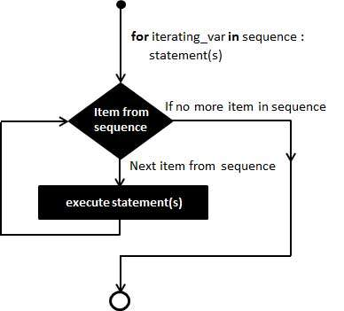
For loop
The for loop is used to repeat an instruction a fixed number of times.
Syntax :
for element in sequence:
do something
Example :
for i in range(0, 10):
print(“I love Python”)
print(“The program is done!”)
Output :
I love Python
I love Python
I love Python
I love Python
I love Python
I love Python
I love Python
I love Python
I love Python
I love Python
The program is done!

Slide 49
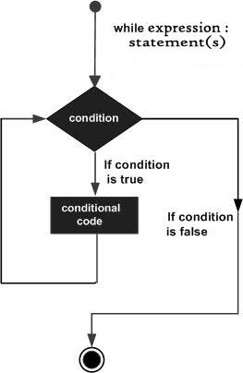
While loop
The while loop is used to repeat an instruction as long as a certain condition is true. Used when you don’t know how many time you should repeat the instruction.
Example :
count = 0
while count < 2:
print(count)
count = count + 1
print ("Good bye!")
Output :
0
1
Good bye!
Be careful with infinite loops !

Slide 50
Break and continue
while True:
letter = input("Type Q to quit")
if letter != ‘Q’:
continue
if letter == ‘Q’:
print("End")
break
Jump directly to the next iteration of the loop
Exit the loop
Notes:
Prefer a loop with a conditon than break
With continue you can go back to the condition in the while

Slide 51
Iterating over a list
You can simply iterate over lists with for or while loops:
for elem in myList:
do something
i=0
while i<len(myList):
do something
i = i+1

Slide 52
Example
Let's suppose we have a list students that contains the name of all students of a
class, we wish to print all the names with strictly more than 6 characters.
How would we achieve that ?
First way:
for name in students:
if len(name)>6:
print(name)
Second way:
i=0
while i<len(students):
if len(students[i])>6:
print(student[i])
i=i+1

Slide 53
Recap: What have we learned so far?
What kind of operators do you remember?
How do you perform division in Python?
What is a Boolean expression?
How can you combine conditions? For example, say you want to check whether someone is older than 18 but younger than 40?
What is a loop?
What is the difference between for loops and while-loops?
How to iterate over a list

Slide 54
Kahoot time!
Instructor link to generate game pin: https://play.kahoot.it/v2/?quizId=3e10707f-3f50-4540-a46a-a1a9d6339f30

Slide 55
2.5 Functions

Slide 56
Why use functions?
Sometimes your Python code becomes a bit long, or you need to copy/paste some parts of your code because you need to use it several times at different places of your code.
Functions are places where you define a pieces of your code to reuse in later.
You already used some functions!
print
input

Slide 57
Defining a function
To define a new function, you simply use this syntax :
def functionName(parameters):
your code
Parameters are the values you wish to pass to your function.
For example, when we use print(“I love Python”) we pass the string “I love Python” to the function print so that it knows what to print.
We also give a name to our function so we can refer to it later.

Slide 58
Calling a function
To call (use) a function that’s already been defined, you just use this syntax :
functionName(parameters)
We might want that our function gives us back a value that it has computed. We can use the keyword return to achieve that.

Slide 59
Example
Suppose that in our code we often need to compute the perimeter of a rectangle. To avoid to write several times the same code we are going to use a function.
def perimeter_rectangle(height, length):
return 2*height + 2*length
And then if we want the perimeter of a rectangle of height 8 and width 12 we can just do:
perimeter = perimeter_rectangle(8, 12)
Don’t forget to use return!

Slide 60
Example 2
Let’s write a function to compute the area of a circle.
Let’s not forget the keyword
Chose a proper name for our function
What is the parameter we need to compute the area of a circle ?
def area_circle(radius):
area = 3.14 * radius * radius
return radius
Let’s do the computation now
Don’t forget to return the result !
How could we now use this function ?

Slide 61
Recap
What types of variables do we know of?
How can we convert between them?
What did we learn about conditional statements? How do we write them?
What do we know about for and while loops?
How does indentation work?
How do we write a function?
What is the difference between defining and calling a function?
When assigning something to a variable, is the variable on the right or left side?

Slide 62
2.6 Object Oriented Programming

Slide 63
A new programming paradigm...
Until now we used the procedural programming paradigm, that is, a way to
code our program with functions, variables, and by putting all our code in one
file.
That’s the most basic way to code, and maybe the easiest.
Today we are going to talk about another way to design our programs:
Object-oriented programming.
This will allow us to separate our program in multiple files, and introduce a new
(and super useful) data structure, objects. In this course we will only have an
introduction about object-oriented programming.

Slide 64
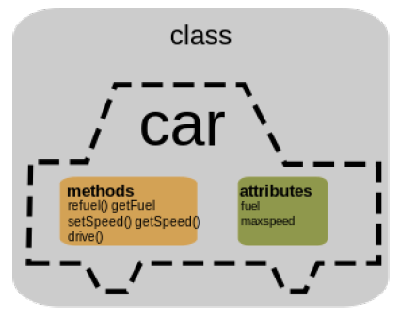
What is an object ?
An object is a data structure that can contain variables and functions.
It is often used to represent some concretes things in your code.
We call the variables of the object attributes and the functions methods.

Slide 65

Example
In a game we wish to represent in our code a bonus cube like this one. What could be attributes and methods of this cube ?
Properties:
Size of the cube
Type of bonus
Cube used or not
Methods:
Break cube

Slide 66
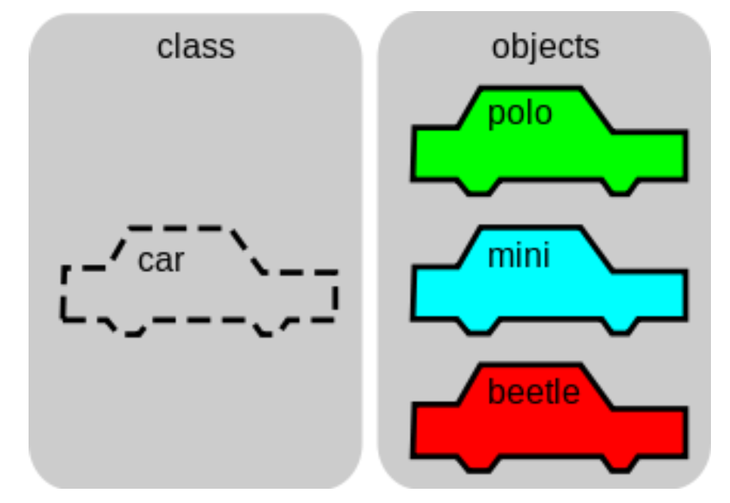
Class
A class is a template for an object, a way to create an object from a model.
For example we can create a class for our bonus cube, and then from this class we can create several bonus cubes with different parameters with different sizes for example.
An object is called an instance of a class.

Slide 67
Creating a class
To create a class first we create a new Python file, that we call the same way as our class.
Then we use this syntax to begin our class :
class nameOfOurClass:
content

Slide 68
The init method
The first thing to do after creating our class is to create the init method. It is a function that is going to be called when we create the object.
It is useful to initialize the object. For example if we have the class Cube we wish that when we do Cube(600, 500) it creates a cube of size 600x500.
To do so we simply create an init method like so:
def __init__(self, parameters):
do actions

Slide 69
The self keyword
In the last slide you’ve seen the “self” keyword. It is a keyword used to refer to the object itself.
You can use it to create variable of the object:
self.size = 5
Now we can access this variable anywhere in our class.

Slide 70
Methods
To create methods that applies to our object now we use this syntax :
def nameOfTheMethod(self, parameters):
do things

Slide 71
Example
Let’s try to create a class that represent a door in a game. Let’s say that a door needs two important pieces of information: if it is open or closed, and if it is locked or no. And there are two actions you can do with a door : open or close it.
class Door:
def __init__(self, open, locked):
self.open = open self.locked = locked
def open(self):
if (not self.locked):
self.open = True
def close(self):
self.open = False

Slide 72
But now how to use our class ?
Now that we have defined our class, we need to have a way to create some objects with it.
If you want to use it in an other file, you first have to import it, like that:
from class import *
For example:
from Door import *
And then you can create an Object and put it in a variable like that :
variableName = Object(parameters)
Example: doorLevel1 = Door(False, True)

Slide 73
Access attributes and use methods
To access an attribute of an object you just do:
objectName.nameOfAttribute
Example:
doorLevel1.Locked
And to use a method it is similar :
objectName.nameOfMethod(parameters)
Example:
doorLevel1.open()

Slide 74
What have we learned so far?
Object-oriented programing is another way to write your programs
An object is a structure that has variables (attributes) and function (methods)

Slide 75
Kahoot time!
Instructor link to generate game pin: https://play.kahoot.it/v2/?quizId=e0072120-777f-492b-83ed-329a6478f6f8

